Slide 1
On the analysis of the operation of a double electrostatic layer in the ion sail mode.
A.S. Lozovoi, K.A. Orekhov, K.G. Petrov,A.A. Tikhonov and A.B. Yakovlev

Slide 2
Introduction
The team of authors is grateful to E.N. Polyakhova for her suggestion to undertake research on the dynamics of space sails.
A logical step in the plans for further space exploration has been the development of fundamentally new propulsion systems capable of operating with minimal consumption of onboard energy sources. Such systems, in particular, include various sail designs: film sails [1, 2], electric sails [3–6], and magnetic sails [7–9].
The thrust of a magnetic sail arises from the magnetostatic interaction between the solar wind and an artificial magnetic field generated onboard the spacecraft by an electric current flowing through an electrical circuit of a given shape. Various configurations of electric sails have been proposed. In one project, the electric sail consists of a number of long, thin tethers held at a high positive potential, which are deployed by spinning the spacecraft about its axis of symmetry. The positive charge on the tethers is maintained by an electron gun on the spacecraft, which emits a beam of electrons directed opposite to the spacecraft's motion. The positively charged tethers repel solar wind ions, resulting in momentum transfer from the ions to the sail and, consequently, acceleration of the spacecraft.

Slide 3
Zubrin’s concept
The present paper considers another variant of the electric sail, the so-called dipole thruster (double electrostatic layer), proposed in [10], which structurally consists of two parallel conducting surfaces made as grids of conductive filaments. The conducting surfaces are separated by an insulating gap, the design of which is determined by the required electrical and mechanical strength and by the minimum possible influence on the electric field between the conducting surfaces. The distance between the conducting surfaces, d, is assumed to be small compared to the characteristic transverse size of the surfaces, D. An accelerating potential difference U is applied between the conducting surfaces, controlled in magnitude and maintained by a power supply (PS). To maintain a constant potential difference between the grids, a device that emits electrons into the surrounding space is attached to the negatively charged surface.
In the present report, the use of the double electrostatic layer is considered only in the ion sail mode.

Slide 4
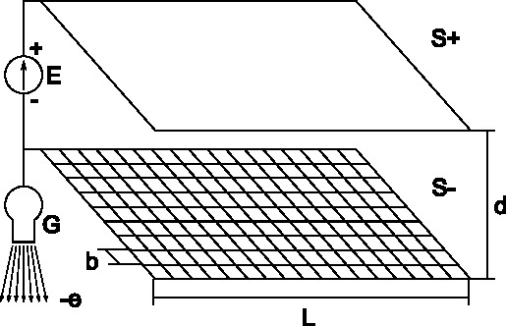
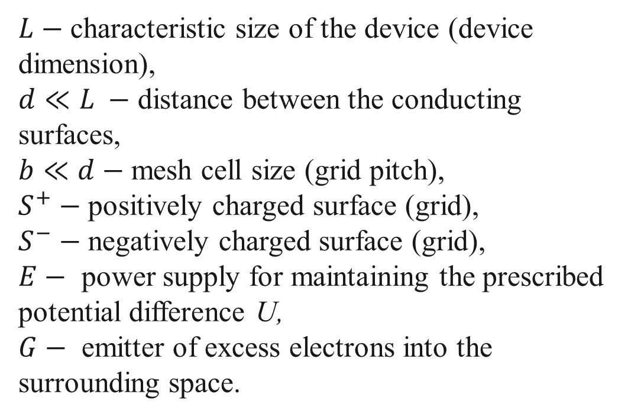
Double electrostatic layer in the ion sail mode. Design.
$L−$ characteristic size of the device (device dimension),
$d≪L −$ distance between the conducting surfaces,
$b≪d−$ mesh cell size (grid pitch),
$S^{+}−$ positively charged surface (grid),
$S^{−}−$ negatively charged surface (grid),
$E−$ power supply for maintaining the prescribed potential difference U,
$G−$ emitter of excess electrons into the surrounding space.
Fig.1

Slide 5
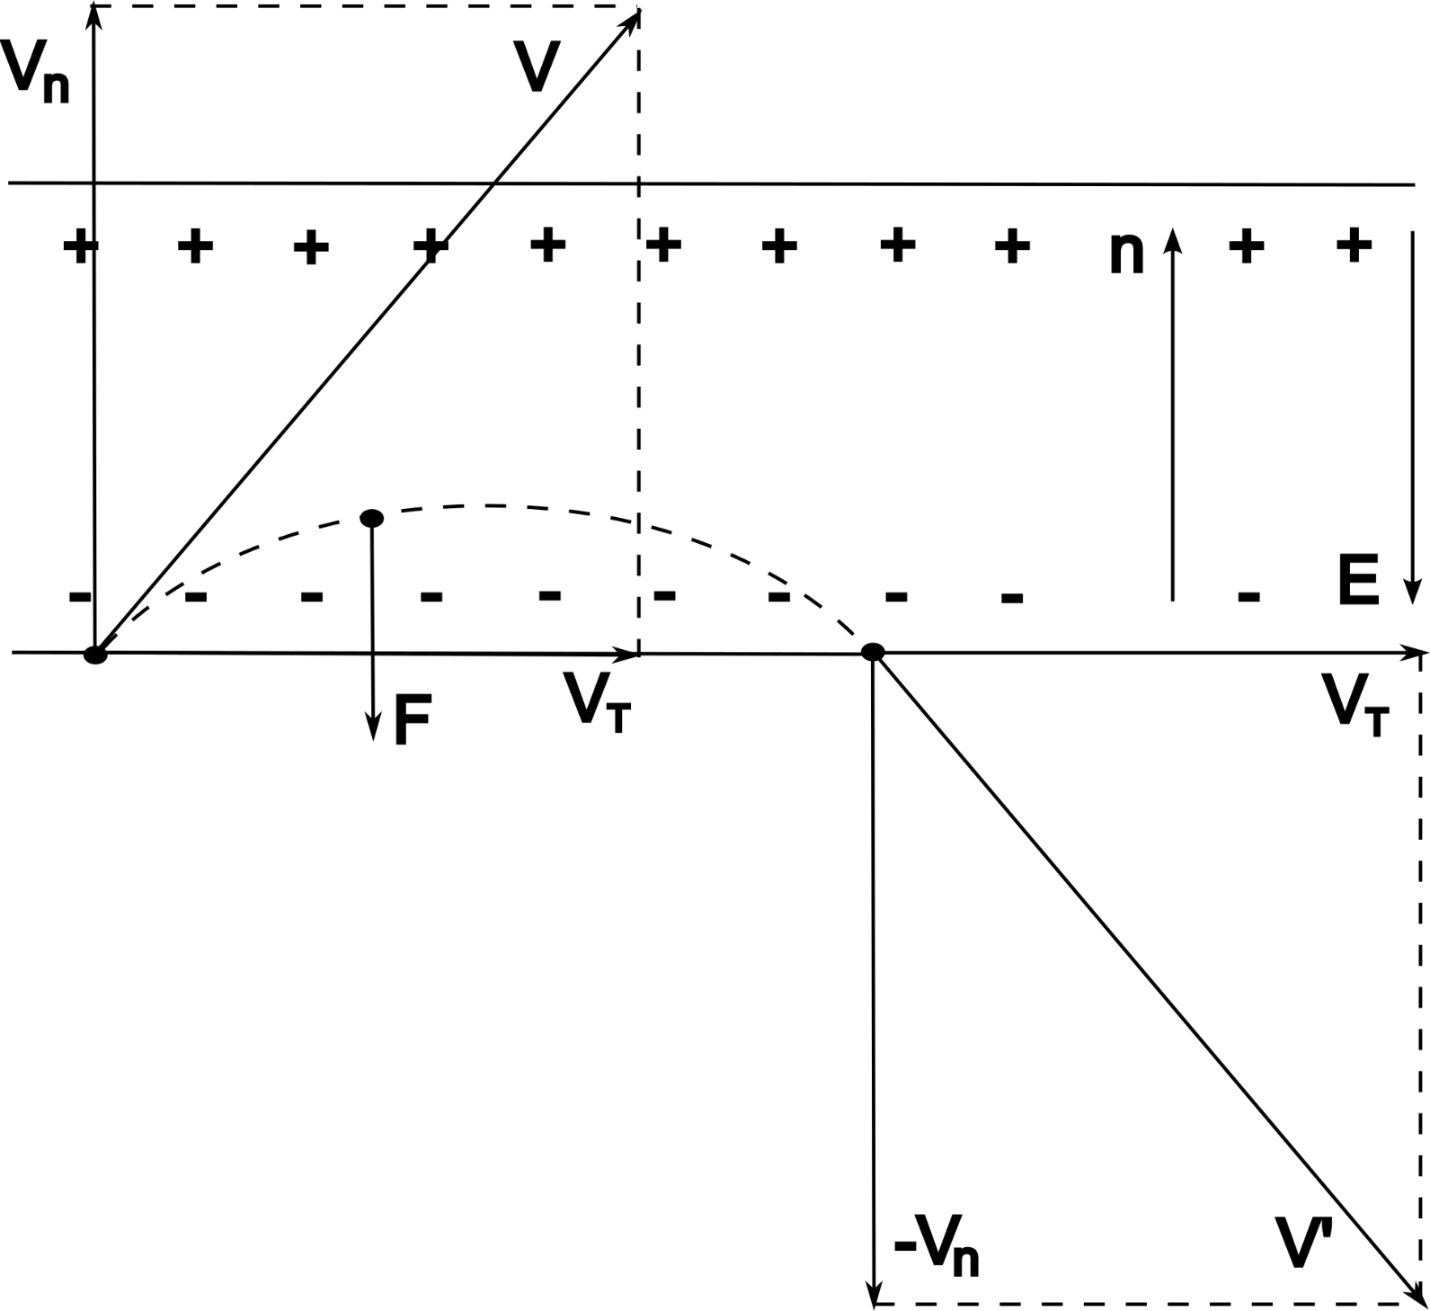
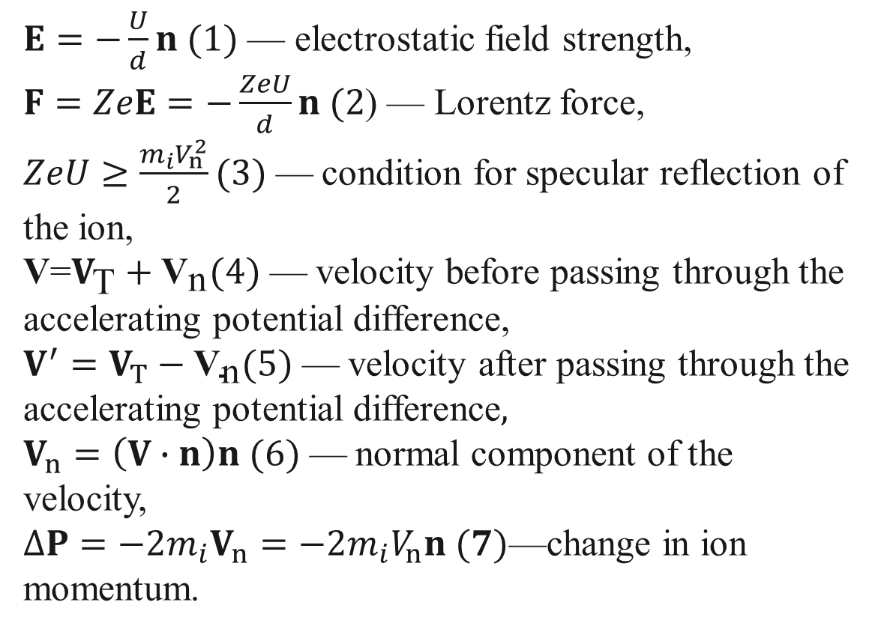
Double Electrostatic Layer in Ion Sail Mode.
Ion motion.
$E=−\frac{U}{d}n (1)$ — electrostatic field strength,
$F=ZeE=−\frac{ZeU}{d}n (2$) — Lorentz force,
$ZeU≥\frac{m_{i}V_{n}^{2}}{2}(3) \text{—}$ condition for specular reflection of the ion,
$\text{V}\text{=}V_{\text{T}}+{\text{V}}_{\text{n}}(4) \text{—}$velocity before passing through the accelerating potential difference,
$V^{′}=V_{T}−{\text{V}}_{\text{n}}(5)$ $\text{—}$velocity after passing through the accelerating potential difference$,$
$V_{n}=\left(V∙n\right)n (6) \text{—}$ normal component of the velocity,
$∆P=−2m_{i}V_{n}=−2m_{i}V_{n}n (7)\text{—}$change in ion momentum.
Fig. 2

Slide 6
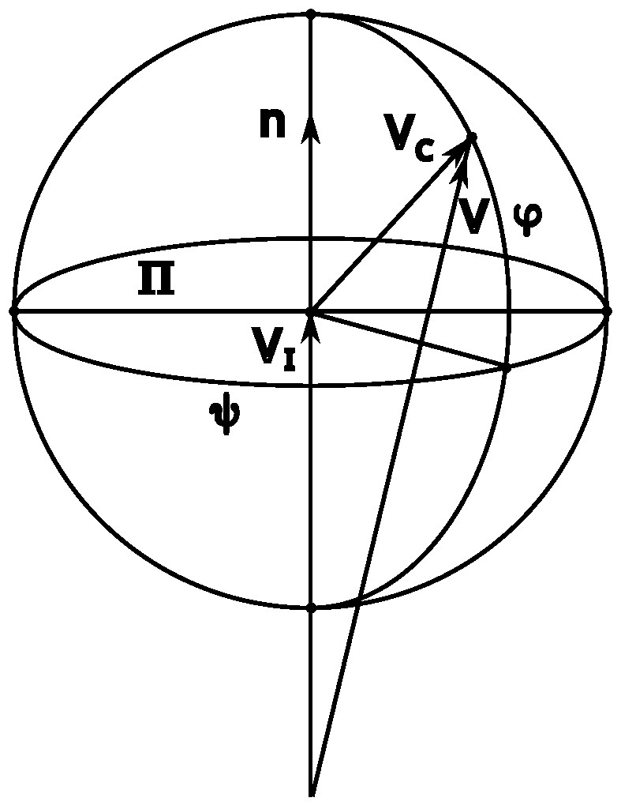
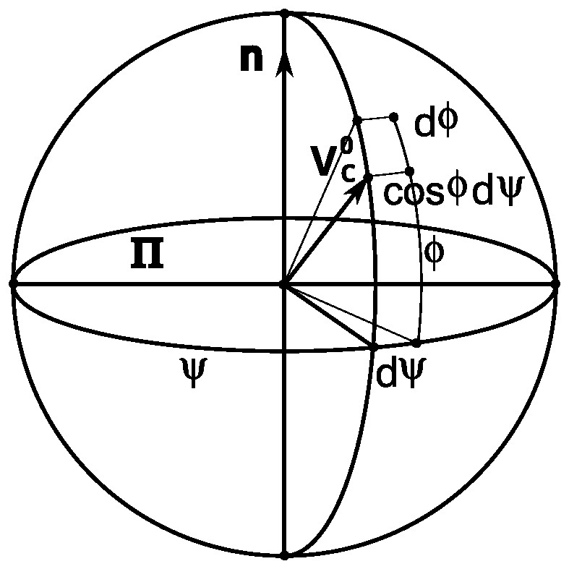
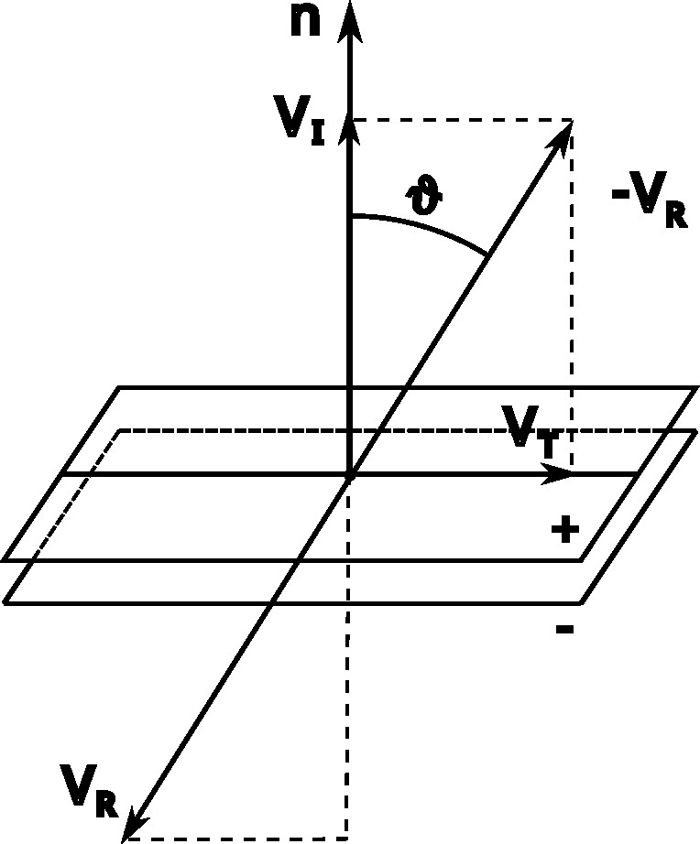
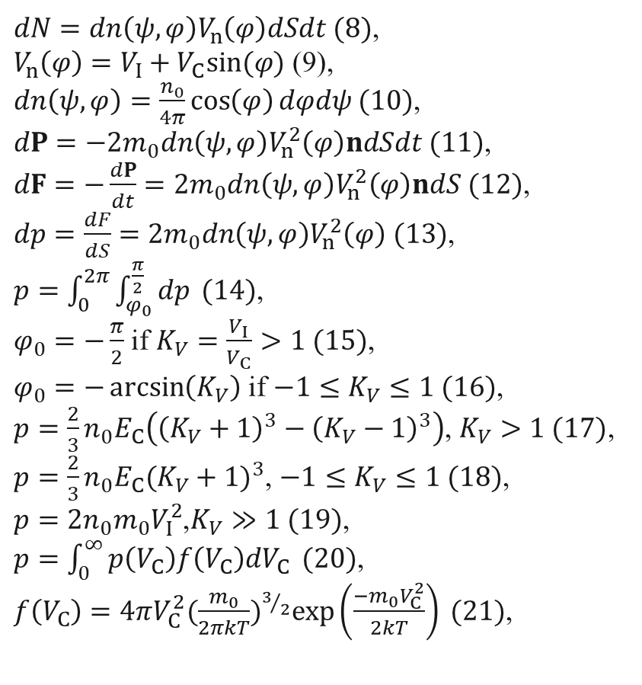
Pressure of the ion flow on the double electrostatic layer in the ion sail mode.
$dN=dn\left(ψ,φ\right)V_{n}\left(φ\right)dSdt (8)$,
$V_{n}\left(φ\right)=V_{I}+V_{C}sin⁡(φ)$ (9),
$dn\left(ψ,φ\right)=\frac{n_{0}}{4π}\cos\left(φ\right)dφdψ (10)$,
$dP=−2m_{0}dn\left(ψ,φ\right)V_{n}^{2}\left(φ\right)ndSdt (11)$,
$dF=−\frac{dP}{dt}=2m_{0}dn\left(ψ,φ\right)V_{n}^{2}\left(φ\right)ndS (12)$,
$dp=\frac{dF}{dS}=2m_{0}dn\left(ψ,φ\right)V_{n}^{2}\left(φ\right) (13)$,
$p=\int_{0}^{2π}{\int_{φ_{0}}^{\frac{π}{2}}{dp}} (14)$,
$φ_{0}=−\frac{π}{2}$ if $K_{V}=\frac{V_{I}}{V_{C}}>1 (15)$,
$φ_{0}=−\arcsin\left(K_{V}\right)$ if $−1≤K_{V}≤1 (16)$,
$p=\frac{2}{3}n_{0}E_{C}\left({\left(K_{V}+1\right)}^{3}−{\left(K_{V}−1\right)}^{3}\right)$, $K_{V}>1 (17)$,
$p=\frac{2}{3}n_{0}E_{C}{(K_{V}+1)}^{3}$, $−1≤K_{V}≤1 (18)$,
$p=2n_{0}m_{0}V_{I}^{2}$,$K_{V}≫1 (19)$,
$p=\int_{0}^{∞}{p\left(V_{C}\right)f\left(V_{C}\right)dV_{C}} (20)$,
$f\left(V_{C}\right)=4πV_{C}^{2}{(\frac{m_{0}}{2πkT})}^{3/2}\exp\left(\frac{−m_{0}V_{C}^{2}}{2kT}\right) (21)$,
Fig. 3
Fig. 4
Fig. 5

Slide 7
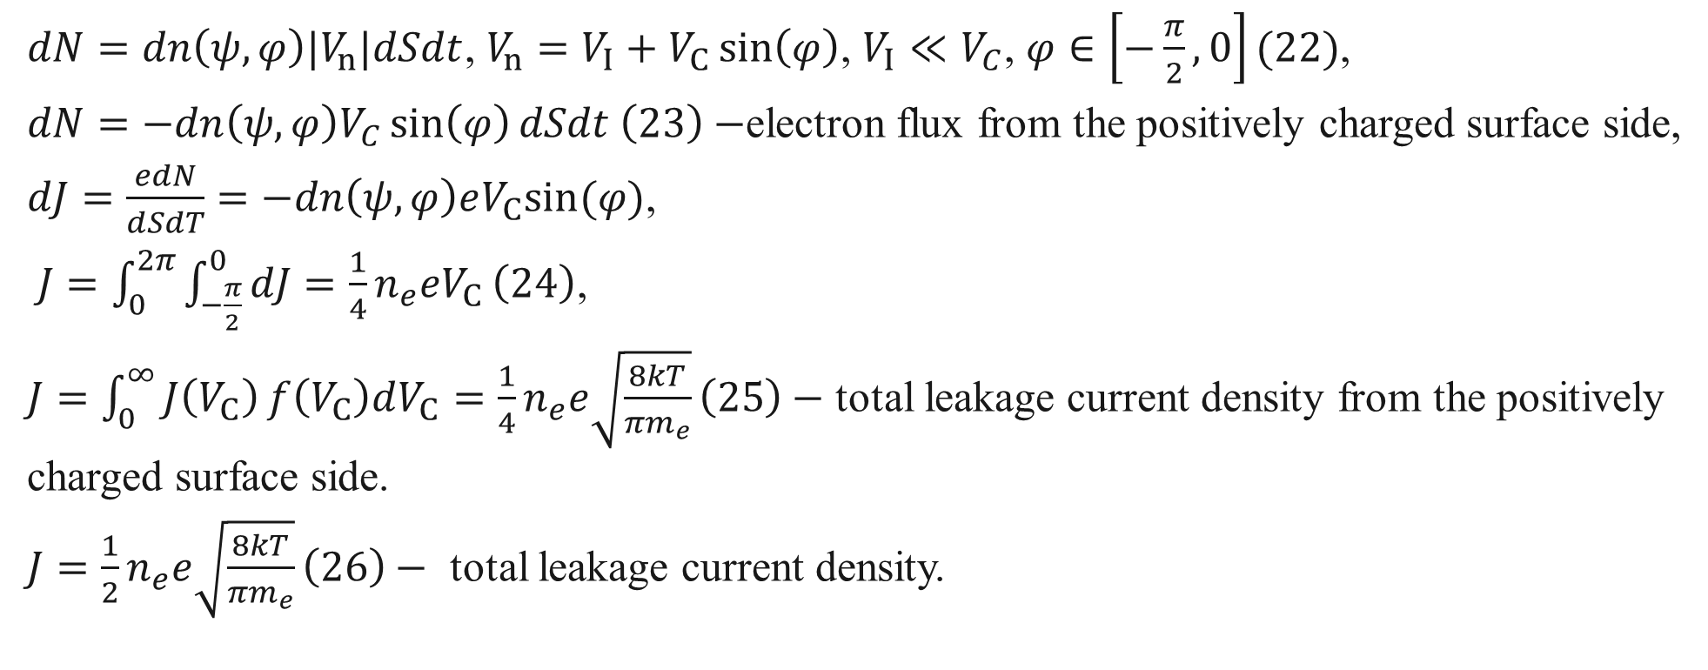
Leakage current density of the double electrostatic layer in the ion sail mode.
$dN=dn\left(ψ,φ\right)|V_{n}|dSdt$, $V_{n}=V_{I}+V_{C}\sin\left(φ\right)$, $V_{I}≪V_{C}$, $φ∈\left[−\frac{π}{2},0\right](22)$,
$dN=−dn\left(ψ,φ\right)V_{C}\sin\left(φ\right)dSdt \left(23\right)−$electron flux from the positively charged surface side,
$dJ=\frac{edN}{dSdT}=−dn\left(ψ,φ\right)eV_{C}sin⁡(φ)$,
$J=\int_{0}^{2π}{\int_{−\frac{π}{2}}^{0}{dJ=\frac{1}{4}n_{e}eV_{C}}}\left(24\right)$,
$J=\int_{0}^{∞}{J\left(V_{C}\right)}f\left(V_{C}\right)dV_{C}=\frac{1}{4}n_{e}e\sqrt{\frac{8kT}{πm_{e}}}\left(25\right)−$ total leakage current density from the positively charged surface side.
$J=\frac{1}{2}n_{e}e\sqrt{\frac{8kT}{πm_{e}}}\left(26\right)−$ total leakage current density.

Slide 8
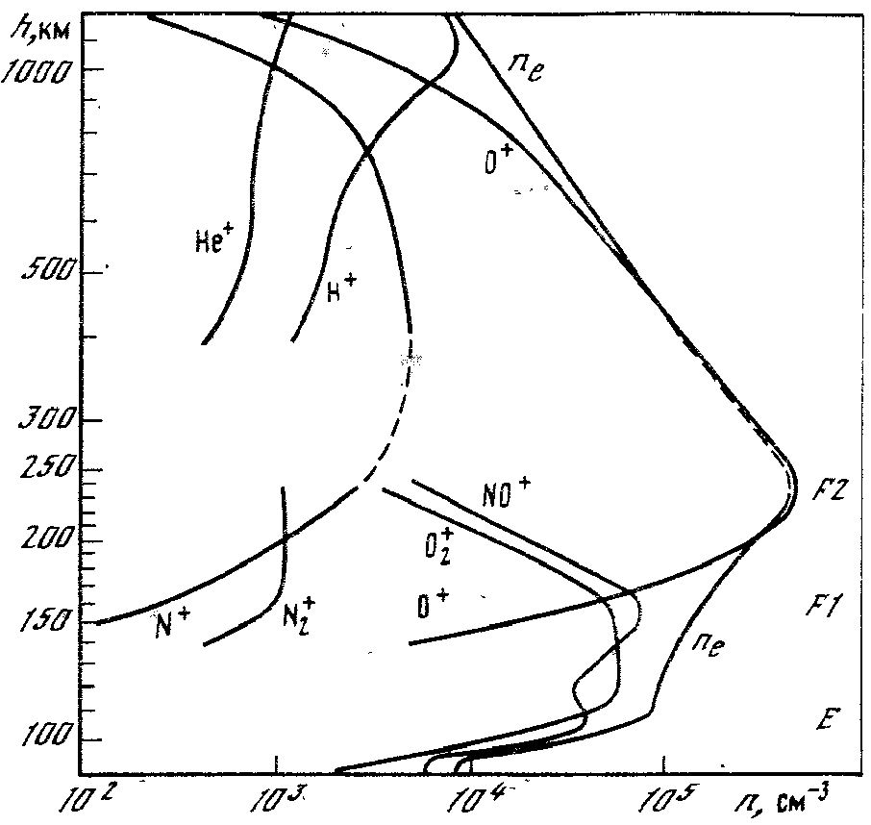
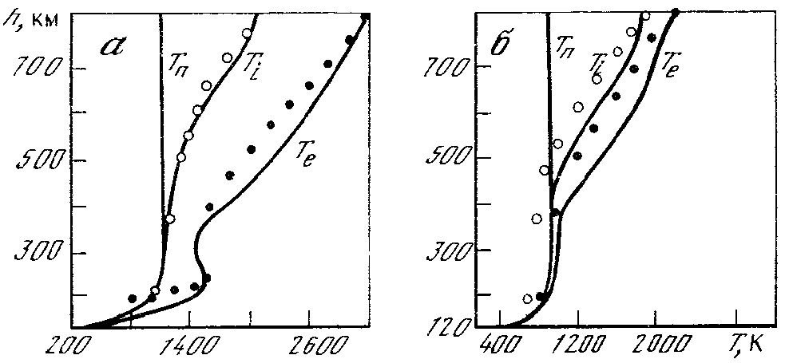
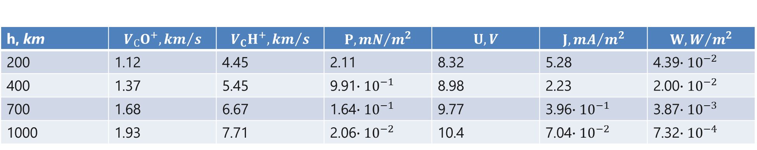
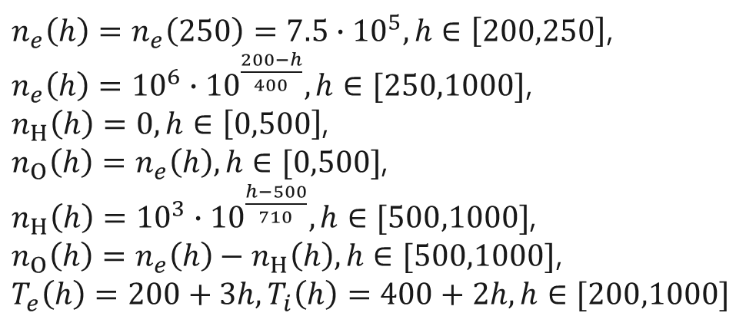
Ion sail in the low Earth orbit region.
$n_{e}\left(h\right)=n_{e}\left(250\right)=7.5∙{10}^{5},h∈\left[200,250\right]$,
$n_{e}\left(h\right)={10}^{6}∙{10}^{\frac{200−h}{400}},h∈[250,1000]$,
$n_{H}\left(h\right)=0,h∈\left[0,500\right]$,
$n_{O}\left(h\right)=n_{e}\left(h\right),h∈[0,500]$,
$n_{H}\left(h\right)={10}^{3}∙{10}^{\frac{h−500}{710}},h∈[500,1000]$,
$n_{O}\left(h\right)=n_{e}\left(h\right)−n_{H}\left(h\right),h∈[500,1000]$,
$T_{e}\left(h\right)=200+3h,T_{i}\left(h\right)=400+2h,h∈[200,1000]$
Fig. 7 [1]
Fig. 6 [1]
h, km | $$V_{С}O^{+}, {km}/s$$ | $$V_{C}H^{+}, {km}/s$$ | $$P, {mN}/{m^{2}}$$ | $$U, V$$ | $$J, {mA}/{m^{2}}$$ | $$W, W/{m^{2}}$$
200 | 1.12 | 4.45 | 2.11 | 8.32 | 5.28 | 4.39$∙{10}^{−2}$
400 | 1.37 | 5.45 | 9.91$∙{10}^{−1}$ | 8.98 | 2.23 | 2.00$∙{10}^{−2}$
700 | 1.68 | 6.67 | 1.64$∙{10}^{−1}$ | 9.77 | 3.96$∙{10}^{−1}$ | 3.87$∙{10}^{−3}$
1000 | 1.93 | 7.71 | 2.06$∙{10}^{−2}$ | 10.4 | 7.04$∙{10}^{−2}$ | 7.32$∙{10}^{−4}$

Slide 9
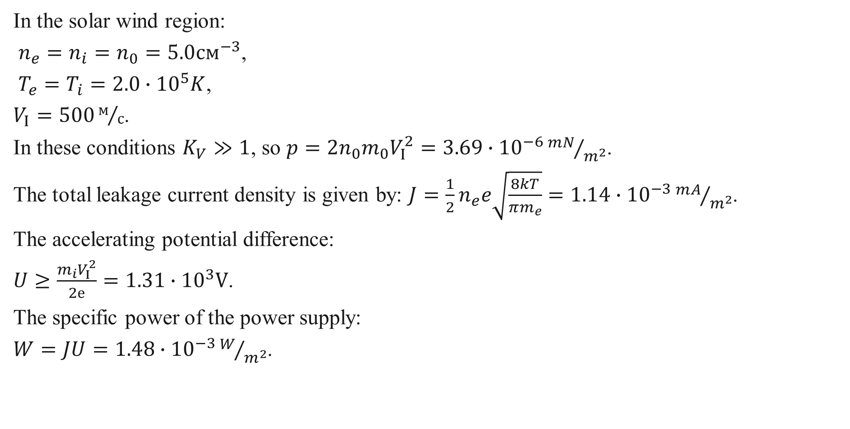
Ion sail under the action of the solar wind.
In the solar wind region:
$n_{e}=n_{i}=n_{0}=5.0{см}^{−3}$,
$T_{e}=T_{i}=2.0∙{10}^{5}K$,
$V_{I}=500м/с$.
In these conditions $K_{V}≫1$, so $p=2n_{0}m_{0}V_{I}^{2}=3.69∙{10}^{−6}{mN}/{m^{2}}$.
The total leakage current density is given by: $J=\frac{1}{2}n_{e}e\sqrt{\frac{8kT}{πm_{e}}}=1.14∙{10}^{−3}{mA}/{m^{2}}$.
The accelerating potential difference:
$U≥\frac{m_{i}V_{I}^{2}}{2е}=1.31∙{10}^{3}V$.
The specific power of the power supply:
$W=JU=1.48∙{10}^{−3}W/{m^{2}}$.

Slide 10
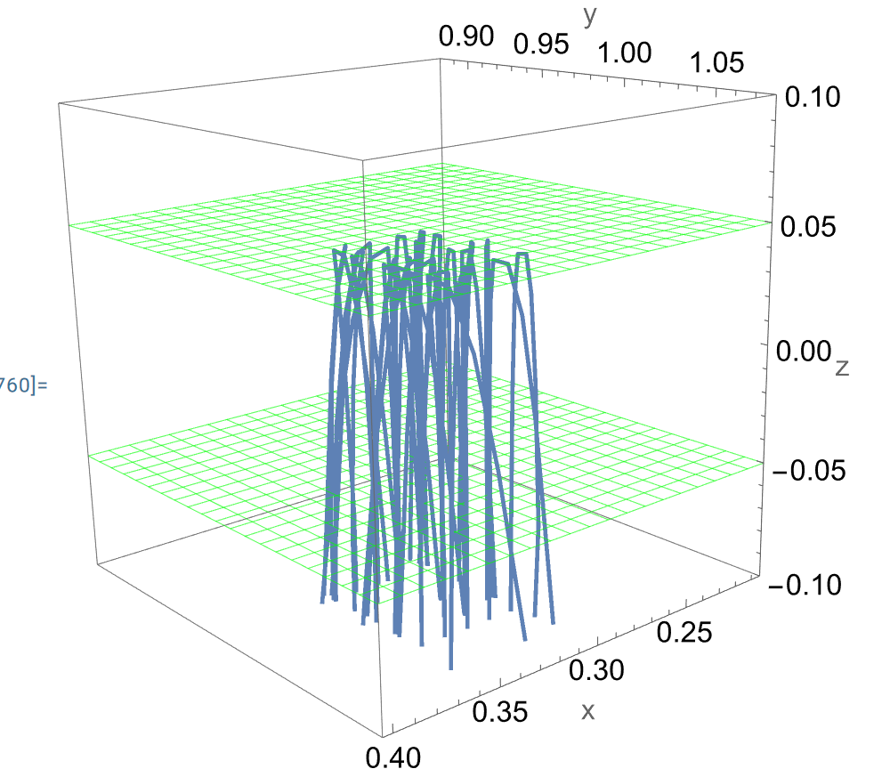
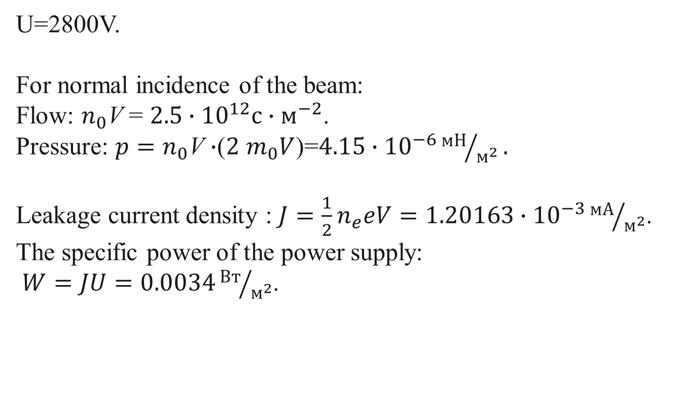
Calculated data
U=2800V.
For normal incidence of the beam:
Flow: $n_{0}$V = $2.5∙{{10}^{12}с∙м}^{−2}$.
Pressure: ${p=n}_{0}$V $∙$($2$ $m_{0}V$)=$4.15∙{10}^{−6}{мН}/{м^{2}}.$
Leakage current density : $J=\frac{1}{2}n_{e}eV=1.20163∙{10}^{−3}{мА}/{м^{2}}$.
The specific power of the power supply:
$W=JU=0.0034{Вт}/{м^{2}}$.
Fig. 8

Slide 11
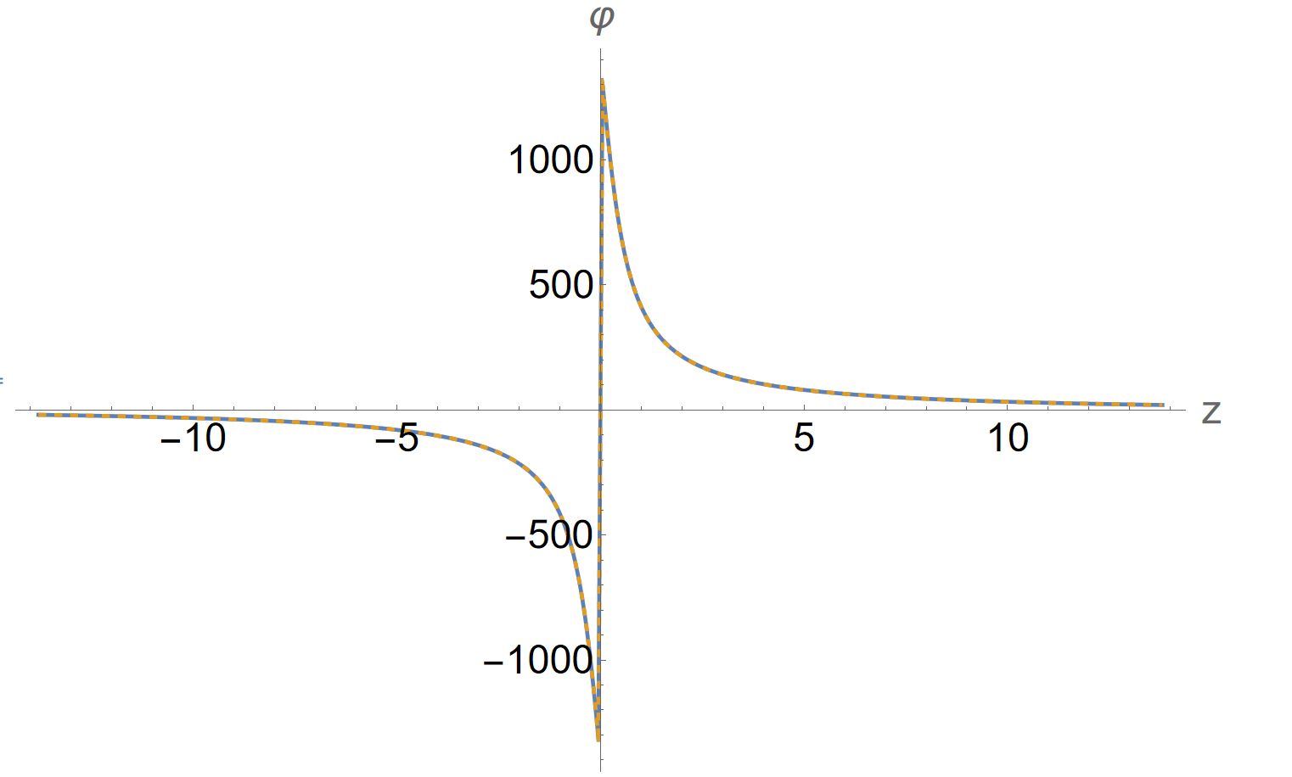
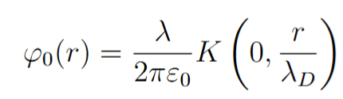
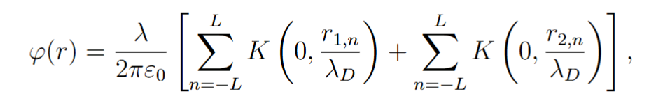
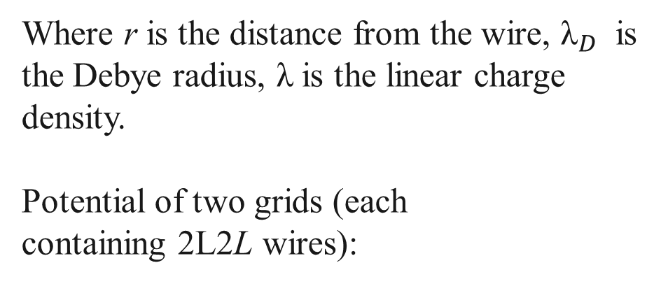
Calculation of the grid potential
Potential of a single wire:
Where r is the distance from the wire, ${\text{λ}}_{D}$​ is the Debye radius, λ is the linear charge density.
Potential of two grids (each containing 2L2L wires):
Fig. 9
where ${\text{r}}_{i,n}$​ is the distance to the n-th wire in the i-th grid.

Slide 12
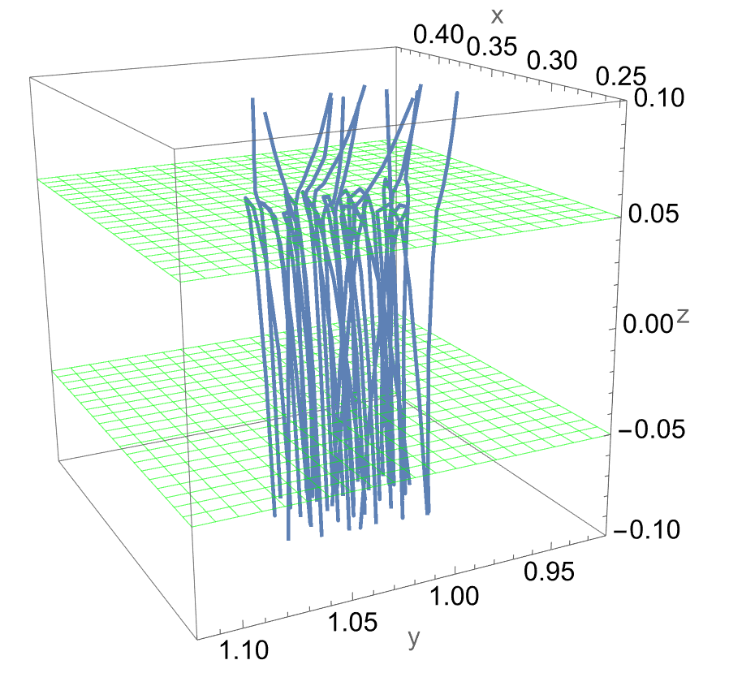
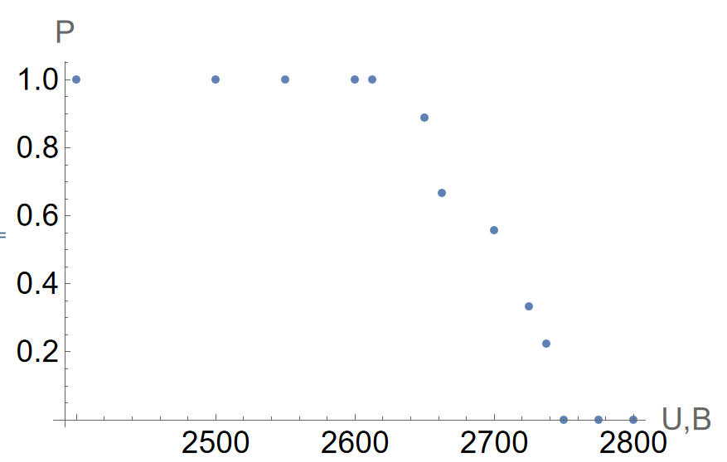

Voltage Variation
Fig. 10
Fig. 11
For the given solar wind parameters, the voltage required for complete ion reflection is 2800 V.

Slide 13
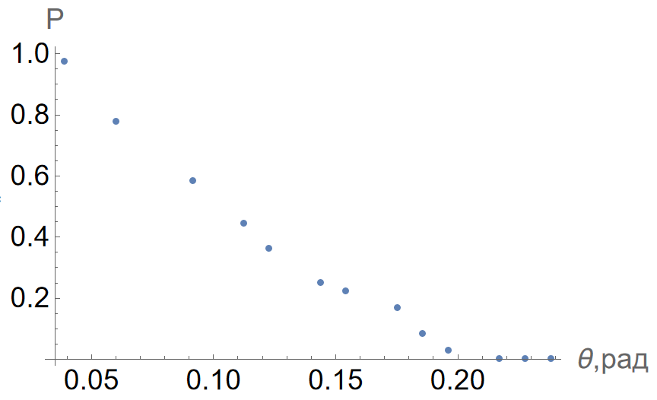
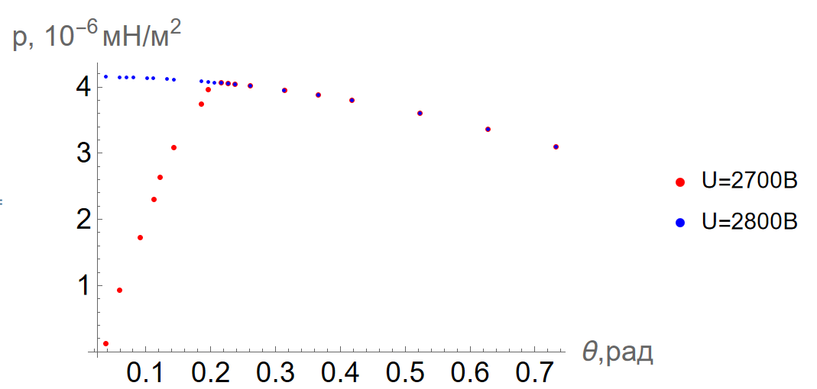


Angle Variation
Fig. 12
Fig. 13

Slide 14
CONCLUSION

Slide 15
Conclusion
An assessment of the feasibility of the double electrostatic layer in the ion sail mode has been performed.
Estimates of the pressure forces acting on the double electrostatic layer in the ion sail mode have been given for low Earth orbits and in interplanetary space under the action of the solar wind.
Estimates of the leakage current density and the electric power consumption of the double electrostatic layer in the ion sail mode have been provided.
Грант РНФ № 24-41-02031, грант DST India № DST/INT/RUS/RSF/P-70/2023(G)

Slide 16
References
1. Polyakhova, E. N. Space Flight by Solar Sail: Problems and Prospects. Moscow: Nauka, 1986. 304 p.
2. Wright J. Space sailing. Abingdon: Routledge, 1992. 258 p.
3. Janhunen P., Sandroos A. Simulation study of solar wind push on a charged wire: Basis of solar
wind electric sail propulsion // Ann. Geophys. 2007. Vol. 25. P. 755–767.
4. Janhunen P. Electric sail for spacecraft propulsion // Journal of Propulsion and Power. 2004.
Vol. 20. N 4. P. 763–764.
5. Toivanen P., Janhunen P., Envall J. Electric sail control mode for amplified transverse thrust //
Acta Astronaut. 2015. Vol. 106. P. 111–119.
6. Palos M. F., Janhunen P., Toivanen P., Tajmar M., Iakubivskyi I, Micciani A., Orsini N.,
Kutt J., Rohtsalu A., Dalbins J., Teras H., Allaje K., Pajusalu M., Niccolai L., Bassetto M., Mengali
G., Quarta A. Q., Ivchenko N., Stude J., Vaivads A., Tamm A., Slavinskis A. Electric sail mission
expeditor, ESME: Software Architecture and Initial ESTCube lunar cubesat E-sail experiment design //
Aerospace. 2023. Vol. 10. P. 694–723. https://doi.org/10.3390/aerospace10080694

Slide 17
References
7. Zubrin R. M., Andrews D. G. Magnetic sails and interplanetary travel // Journal of Spacecraft
and Rockets. 1991. Vol. 28. N 2. P. 197–203.
8. Andrews D. G., Zubrin R. M. Use of magnetic sails for Mars exploration missions // Papers of
the American Institute of Aeronautics and Astronautics. 1989. P. 202–210.
9. Zubrin R. M. The use of magnetic sails to escape from the low Earth orbit // Journal of the
British Interplanetary Society. 1993. Vol. 46. P. 3–10.
https://doi.org/10.1016/j.actaastro.2018.10.028
10. Zubrin R. The Dipole Drive: A new Concept in Propellantless Propulsion / 70th
International Astronautical Congress (IAC), Washington DC, 20-26 October 2019:
https://www.researchgate.net/publication/330210275

Slide 18

authors: A.S. Lozovoi, K.A. Orekhov, K.G. Petrov,A.A. Tikhonov and A.B. Yakovlev
a.lozovoy@spbu.ru
st024389@spbu.ru
konstantin.g.petrov@spbu.ru
a.tikhonov@spbu.ru
a.b.yakovlev@spbu.ru
Санкт-Петербург, Университетская наб., д. 7–9
spbu@spbu.ru

